Slide 1

DEPARTMENT OF COMPUTER SCIENCE AND ENGINEERING
Title: Deep learning-Based structural Damage Detection in wind turbine Blades using YOLOv8 Segmentation
BATCH ID : 23MPCS-G11
S. No | Roll. No | Student Name
1 | 23881A05CP | Dhivyah Penamala
2 | 23881A05DP | M. Sri Thanvi Reddy
3 | 23881A05DZ | Priyanshu Raj Singh
Guide Details
Ms. Ashima jain
Assistant Professor
Department of CSE

Slide 2
Mini Project Outlines
Introduction
Existing System Vs Proposed
Research Gaps
Problem Statement
Proposed Project Objectives
Proposed Project Outcomes
Software and Hardware Requirements
Architectural Diagram
Proposed Methods and Algorithms
Results
Research Paper (Acceptance Proofs)
Conclusion

Slide 3
Introduction
Wind energy is an important renewable energy source, and wind turbine blades play a key role in energy generation. However, these blades can get damaged due to environmental conditions. This project uses deep learning and YOLOv8 to detect damages in blade images, helping to improve maintenance and efficiency.

Slide 4
Existing System Vs Proposed
Existing System | Proposed System
Manual inspection or human analysis | Automated using YOLO deep learning
Time-consuming and costly | Fast and real-time detection
Risky and less safe | Safe (no manual risk)
Less accuracy (human errors) | High accuracy
Difficult to detect small defects | Detects small and complex defects easily
DEPARTMENT OF CSE : MINI PROJECT

Slide 5
Research Gaps
Existing methods rely more on manual inspection, which is time-consuming.
Many models have low accuracy in detecting small or complex damages.
Limited use of advanced deep learning models like YOLOv8.
Lack of real-time and automated detection systems.
Insufficient datasets for different types of blade damages.
DEPARTMENT OF CSE : MINI PROJECT

Slide 6
Problem Statement
Wind turbine blades are exposed to harsh environmental conditions, which can cause damages like cracks, erosion, and surface defects. Traditional inspection methods are manual, time-consuming, and may lead to human errors. There is a need for an automated system that can accurately detect blade damages using images.
DEPARTMENT OF CSE : MINI PROJECT

Slide 7
Proposed Project Objectives
To detect structural damages in wind turbine blades using deep learning.
To develop a YOLOv8-based model for accurate damage identification.
To reduce manual inspection and improve efficiency.
To analyze blade conditions using image processing techniques.
To build a simple system for uploading images and viewing results.
DEPARTMENT OF CSE : MINI PROJECT

Slide 8
Proposed Project Outcomes
Accurate detection of damages in wind turbine blades using YOLOv8.
Faster and efficient identification of cracks and erosion.
Reduced need for manual inspection and human effort.
Improved maintenance and reliability of wind turbines.
User-friendly system to upload images and view results.
DEPARTMENT OF CSE : MINI PROJECT

Slide 9
Software and Hardware Requirements
Software Requirements
Python
Libraries: NumPy, Pandas, OpenCV
Model: YOLOv8 (Ultralytics)
Deep Learning Framework: PyTorch
VS Code
Streamlit (for UI)
Hardware Requirements
Laptop
8 GB RAM
i5 Processor
DEPARTMENT OF CSE : MINI PROJECT

Slide 10
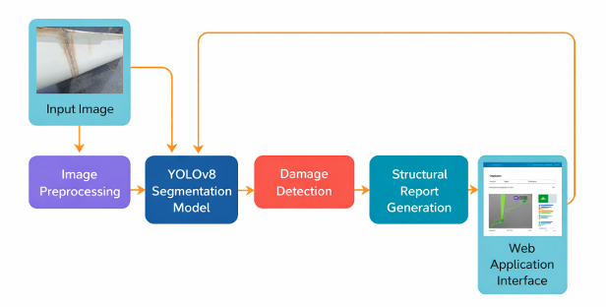
Architectural Diagram
DEPARTMENT OF CSE : MINI PROJECT

Slide 11
PROPOSED METHOD AND ALGORITHMS
Proposed Method
Collect wind turbine blade images from dataset or captured sources.
Preprocess the images by cleaning, resizing, and organizing them.
Annotate damaged areas such as cracks and erosion.
Train the YOLOv8 segmentation model using the prepared dataset.
Test the model on new images to detect blade damage.
Display the output through Streamlit interface with detected regions.
Algorithms Used
YOLOv8 Segmentation – for detecting and segmenting damaged regions in blade images.
Image Preprocessing – for resizing and improving input images.
Data Annotation – for marking damage areas in training images.
Deep Learning Training Algorithm – for learning defect patterns from the dataset.
DEPARTMENT OF CSE : MINI PROJECT
DEPARTMENT OF CSE : MINI PROJECT

Slide 12
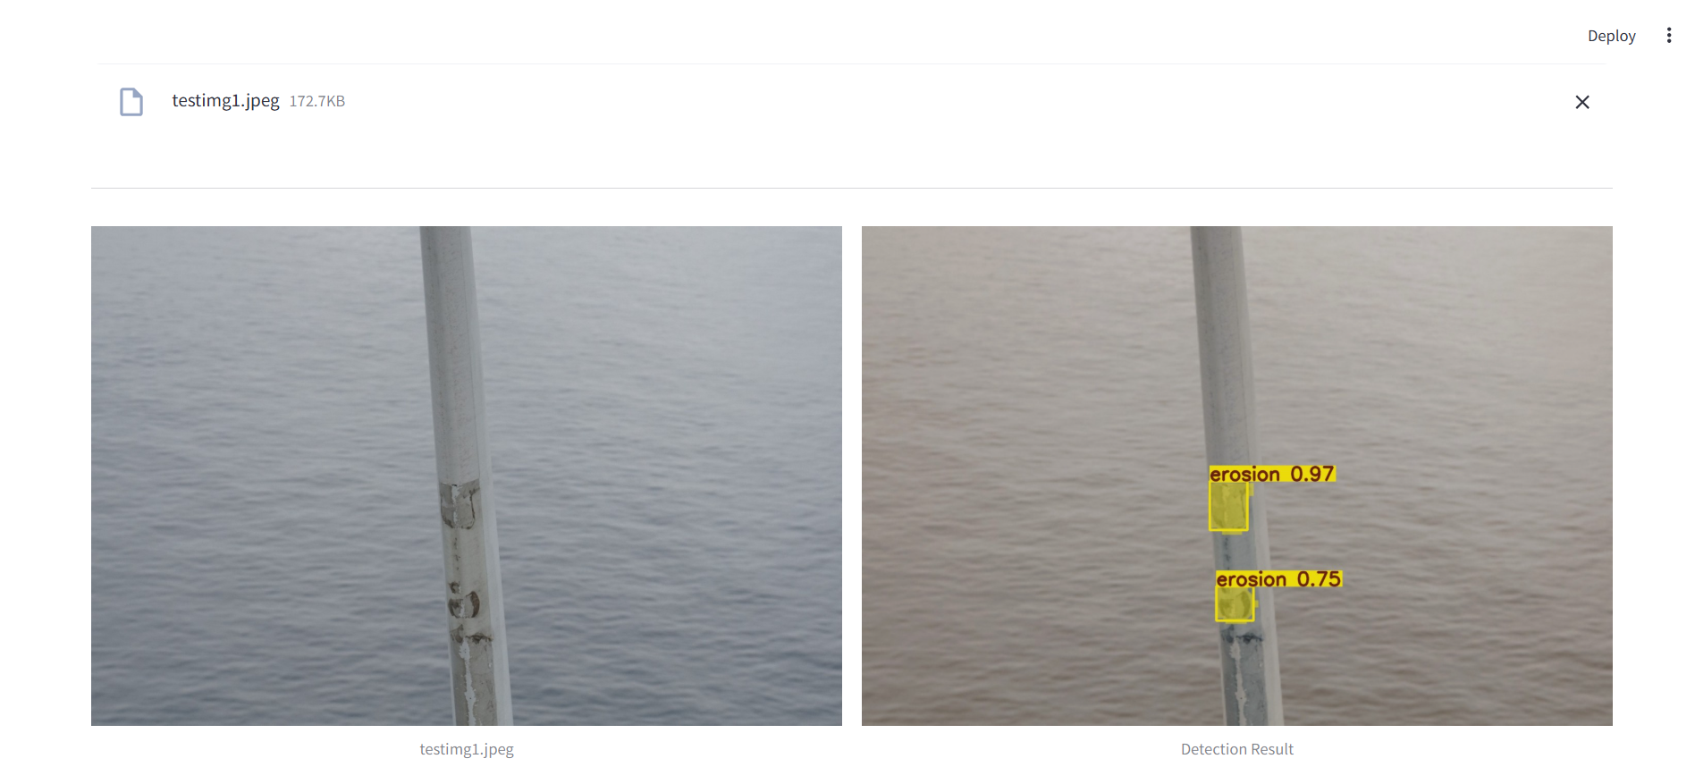
Results
DEPARTMENT OF CSE : MINI PROJECT

Slide 13
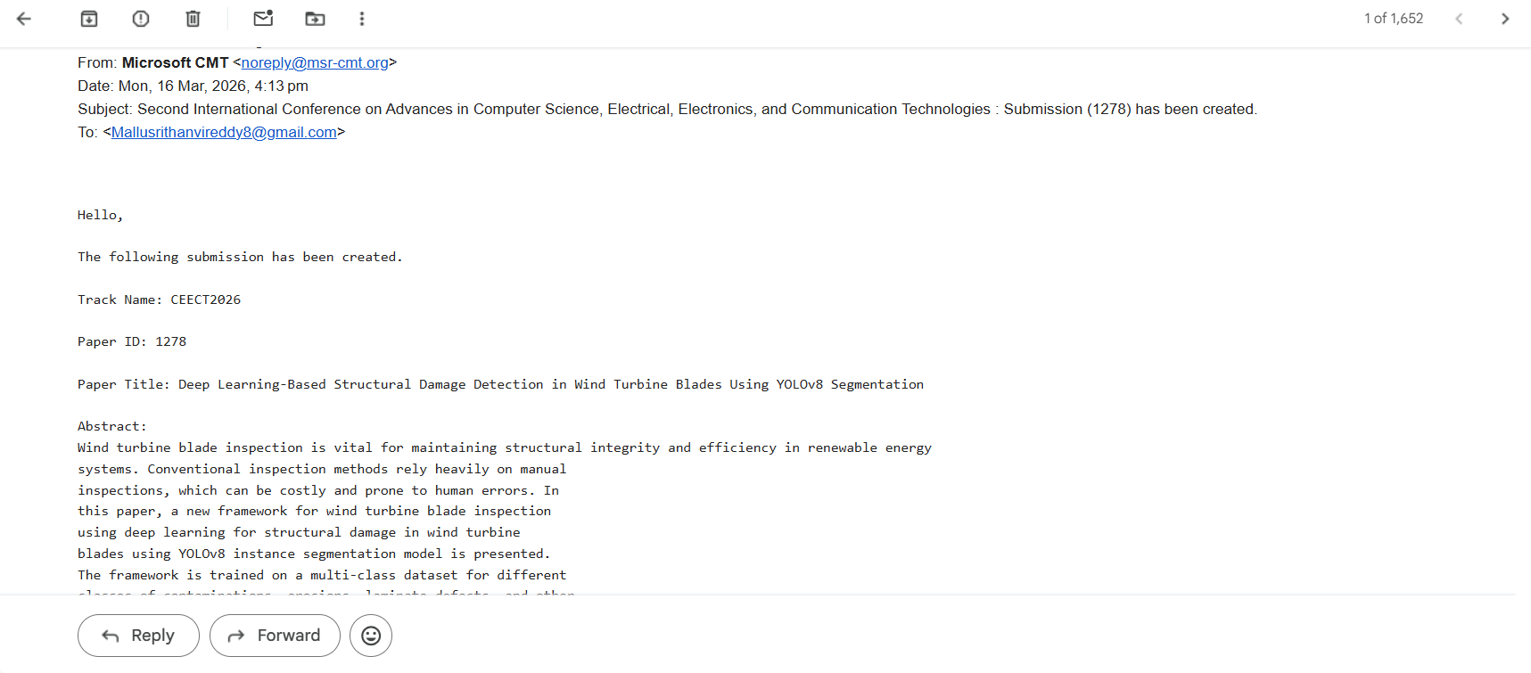
Research Paper (Acceptance Proof)
DEPARTMENT OF CSE : MINI PROJECT
DEPARTMENT OF CSE : MINI PROJECT

Slide 14
Conclusion
This project presents a deep learning-based approach for detecting damage in wind turbine blades using YOLOv8. The system helps in identifying defects accurately and reduces manual effort. It improves maintenance efficiency and supports reliable renewable energy systems.
DEPARTMENT OF CSE : MINI PROJECT

Slide 15
Thank You
DEPARTMENT OF CSE : MINI PROJECT

